Slide 1
A newspaper is better than a magazine. A seashore is a better place than the street. At first it is better to run than to walk. You may have to try serval times. It takes some skill, but it is easy to learn. Even young children can enjoy it. Once successful, complications are minimal. Birds seldom get too close. Rain, however, soaks in very fast. Too many people doing the same thing can also cause problems. One needs lots of room. If there are no complications, it can be very peaceful. A rock will serve as an anchor. If things break loose from it, however, you will not get a second chance.

Slide 2
“the curse of knowledge”
The importance of context

Slide 3
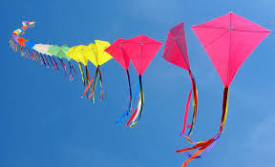

Slide 4
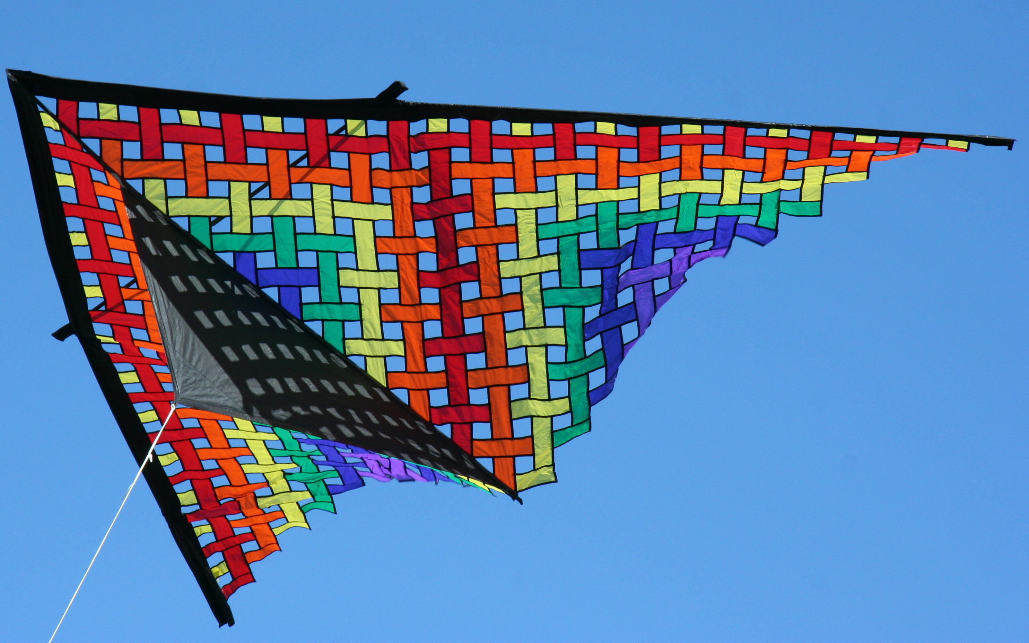

Slide 5
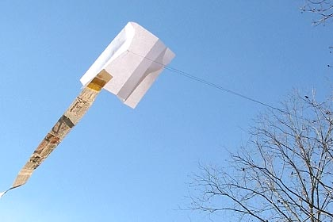

Slide 6
A newspaper is better than a magazine. A seashore is a better place than the street. At first it is better to run than to walk. You may have to try serval times. It takes some skill, but it is easy to learn. Even young children can enjoy it. Once successful, complications are minimal. Birds seldom get too close. Rain, however, soaks in very fast. Too many people doing the same thing can also cause problems. One needs lots of room. If there are no complications, it can be very peaceful. A rock will serve as an anchor. If things break loose from it, however, you will not get a second change.

Slide 7
I hope that makes sense (now)

Slide 8
